Slide 1
Debugger
Presented By : Sameer Shrestha

Slide 2
What is a Debugger?
What is a Debugging?
“Debugging is a methodical process of finding and reducing the number of bugs, or defects, in a computer program or a piece of electronic hardware, thus making it behave as expected.”
-wikipedia
“A software tool that is used to detect the source of program or script errors, by performing step-by-step execution of application code and viewing the content of code variables.”
-MSDN

Slide 3
Debugger (contd.)
A debugger or debugging tool is a computer program that is used to test and debug other programs.
The code to be examined might alternatively be running on an instruction set simulator .
When the program crashes, the debugger shows the actual position in the original code if it is a source-level debugger, commonly now seen in Integrated Development Environments (IDE).
If it is a low-level debugger or a machine-language debugger it shows that line in the program.

Slide 4
Debugger in Embedded System (Example)
Generally, high-level programming languages, such as Java, make debugging easier, because they have features such as exception handling that make real sources of erratic behaviour easier to spot.
In programming languages such as C or assembly, bugs may cause silent problems such as memory corruption, and it is often difficult to see where the initial problem happened. In those cases, memory debugger tools may be needed.
For debugging electronic hardware (e.g., computer hardware) as well as low-level software (e.g., BIOSes, device drivers) and firmware, instruments such as oscilloscopes, logic analyzers or in-circuit emulators (ICEs) are often used, alone or in combination.

Slide 5
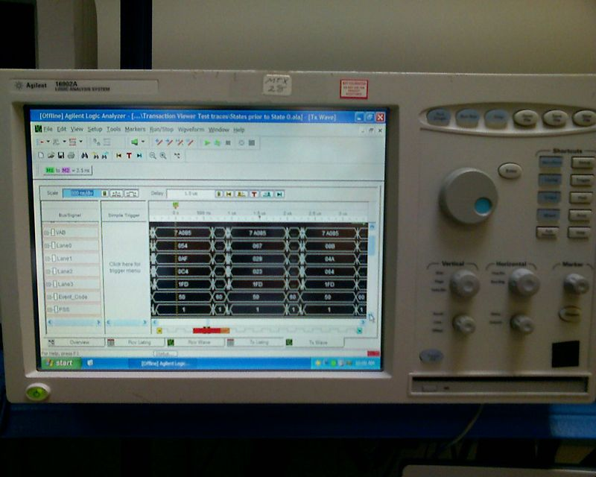
Debugger in Embedded System (contd.)
A logic analyzer is an electronic instrument that captures and displays multiple signals from a digital system or digital circuit.
A logic analyzer may convert the captured data into timing diagrams, protocol decodes, state machine traces, assembly language, or may correlate assembly with source-level software.
Logic Analyzers have advanced triggering capabilities, and are useful when a user needs to see the timing relationships between many signals in a digital system.

Slide 6
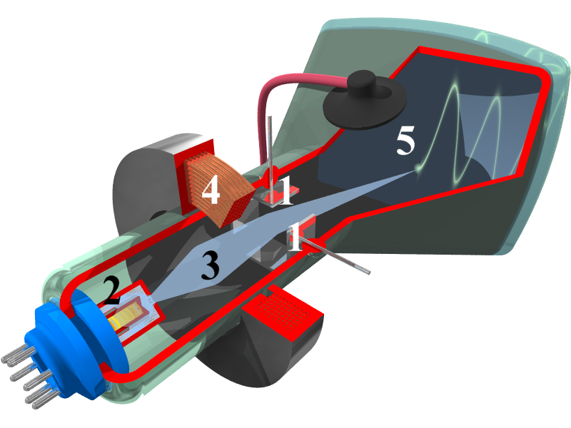
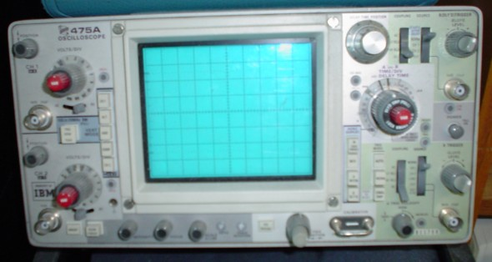
Debugger in Embedded System (contd.)
An oscilloscope, (oscillograph) is a type of electronic test instrument that allows observation of constantly varying signal voltages. Non-electrical signals (such as sound or vibration) can be converted to voltages and displayed.
Oscilloscopes are used to observe the change of an electrical signal over time, such that voltage and time describe a shape which is continuously graphed against a calibrated scale.

Slide 7
Why use a Debugger?
No need for precognition of what the error might be.
Flexible
Allows for “live” error checking – no need to re-write and re-compile when you realize a certain type of error may be occurring
Dynamic
Can view the entire relevant scope

Slide 8
Debugging techniques, 1
Execution tracing
running the program
print
trace utilities
single stepping in debugger
hand simulation

Slide 9
Debugging techniques, 2
Interface checking
check procedure parameter number/type (if not enforced by compiler) and value
defensive programming: check inputs/results from other modules
documents assumptions about caller/callee relationships in modules, communication protocols, etc
Assertions: include range constraints or other information with data.
Skipping code: comment out suspect code, then check if error remains.

Slide 10
Application of Debugger
We can take advantage of the increased speed and visibility available in a desktop computing environment by doing as much debugging within this environment as possible.
Use the IDE, virtualization, simulation and middleware tools for debugging.
With a remote debugger, you can analyze and display debug information and then it is possible to visualize the flow of the code, regardless of how complex that code is.

Slide 11
Debugging an embedded system
Embedded systems are designed to accomplish a very specific task or group of tasks.
It is likely that the designer must balance constraints such as robustness, small size and weight, real-time requirements, long life cycle, low price, and low (or no) tolerance for malfunctions.
While developing embedded systems under some operating systems, we often need to use a hardware debugger, a physical device that connects to target hardware via a JTAG (Joint Test Action Group) interface.

Slide 12
Use of High and low level debugging tools
Use IDE JTAG and Login Analyzer for low level and hardware debugging.
The low level tools are mostly useful during the hardware debugging and early stages of a project, e.g. device driver development.
However complex systems require more than use of simple set breakpoint and CPU register analysis.
Some of the IDEs provide RTOS awareness to provide RTOS information which improve the visibility of the code to the user.
Use a high level tool for debugging at protocol level to understand the characteristics of your system.

Slide 13
Debugger (Features)
Setting breakpoints and controlling program execution.
running a program step by step(single-stepping or program animation), stopping (breaking) (pausing the program to examine the current state) at some event or specified instruction by means of a breakpoint, and tracking the values of variables.
Ability to modify program state while it is running. It may also be possible to continue execution at a different location in the program to bypass a crash or logical error.

Slide 14
Thank You!

